Slide 1

Module 4: Pandas
DS 522 Data Acquisition and Analytics

Slide 2
AGENDA
DataFrame
Series
Reindexing
Dropping Entries
Index, Selection, and Filtering
Fill NaNs and Nas
Apply and Map
Sort and Rank

Slide 3



Getting Started with pandas
Pandas is designed for working with tabular or heterogeneous data.
import convention:
Commonly used pd datastructure:
Series
DataFrame
Importing Series and DataFrame into the local namespace

Slide 4
Pandas Data Structures: Series and Dataframes

Slide 5
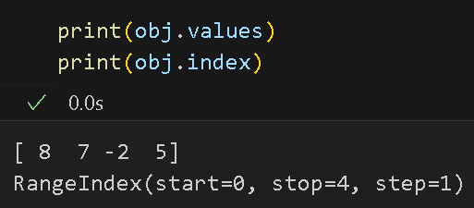
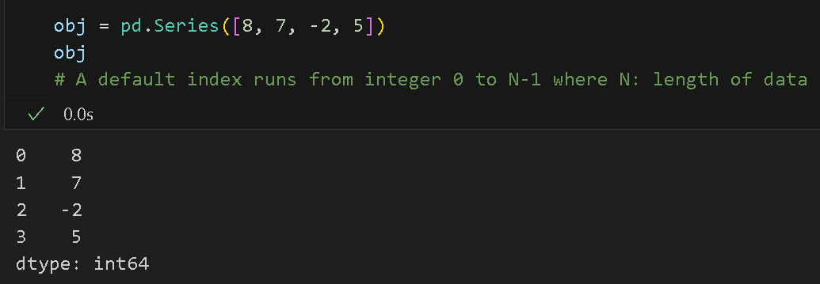
Introduction to Pandas Series
A series is a one-dimensional array-like object containing a sequence of values and an associated array of index (data labels).
Retrieve values and index object of the Series:

Slide 6
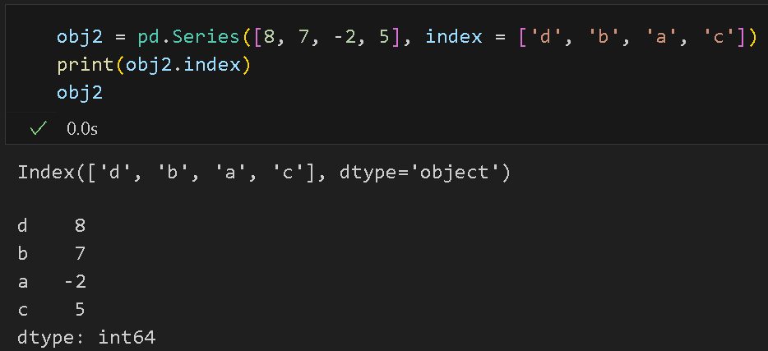
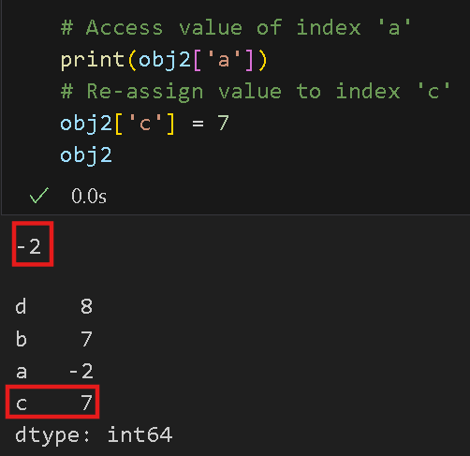
Introduction to Pandas Series
Series created with an index identifying each data point:
use index labels to assign and select values:

Slide 7
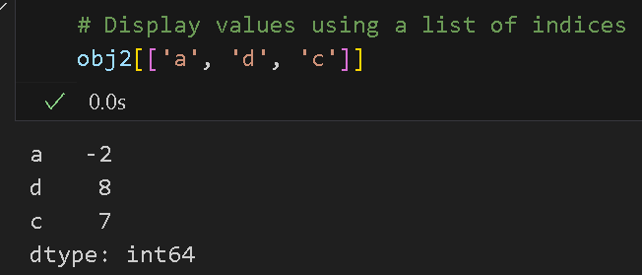
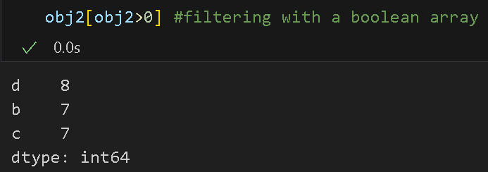
Introduction to Pandas Series
Display values using a list of indices.
Using Numpy functions or Numpy-like operations will preserve the index-value link:

Slide 8
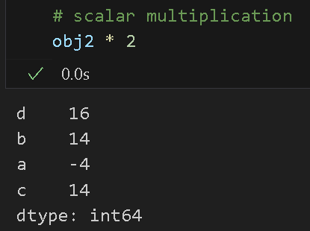
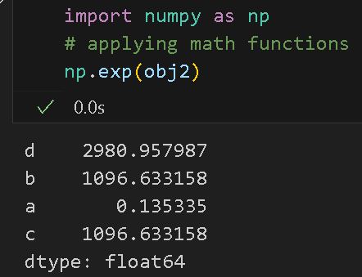
Introduction to Pandas Series
Using Numpy functions or Numpy-like operations will preserve the index-value link:

Slide 9
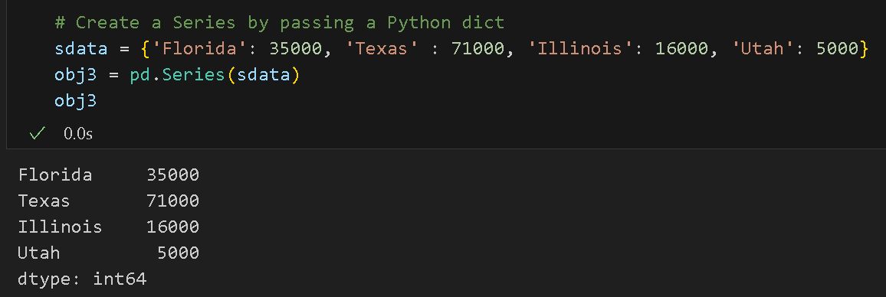
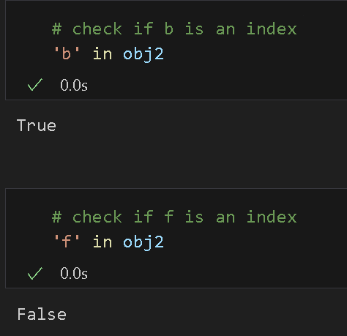
Introduction to Pandas Series
Using Series like a dict for a set operation:
Create a Series by passing a Python dict:

Slide 10
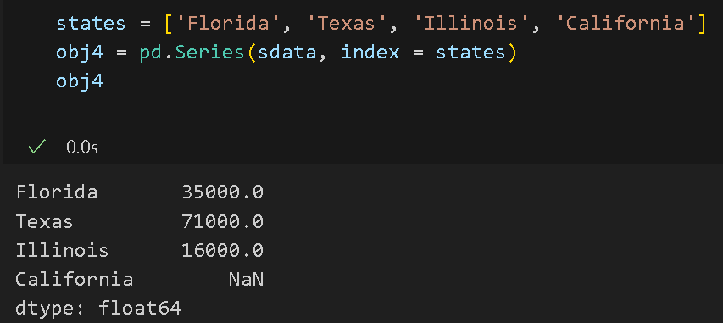
Introduction to Pandas Series
Passing both the data and index:
California has NaN (missing or NA values) since ‘California’ is not present in sdata.

Slide 11
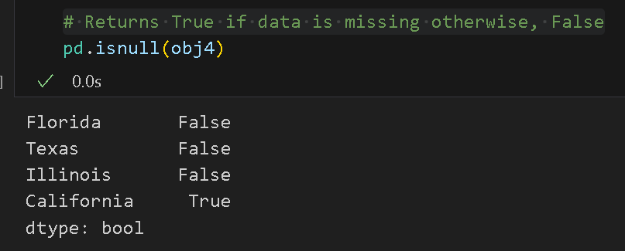
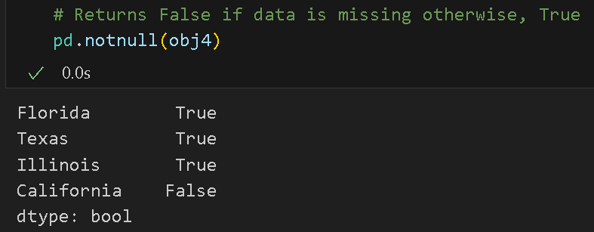
Introduction to Pandas Series
The isnull and notnull functions in pandas are used to detect missing data.

Slide 12
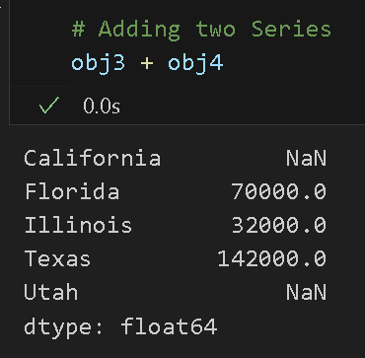
Introduction to Pandas Series
A Series automatically align by index label in arithmetic operations
Example: Adding two Series
# California and Utah are assigned NaN as they don’t have proper numerical values on both obj3 and obj4.

Slide 13
Introduction to Pandas DataFrame
DataFrame - ordered collection of columns represented as two-dimensional tabular data
each column can have different data types(numeric, string, boolean, etc.)
with row index and column index.
a dict of Series sharing the same index
stored as one or more two-dimensional blocks
use hierarchical indexing to represent higher dimensional data (> 2 dimension) in a tabular format.

Slide 14
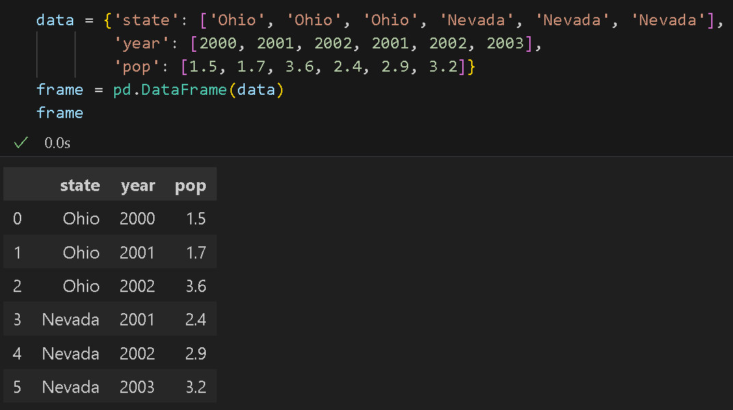
Introduction to pandas DataFrame
One most common way to construct a DataFrame is from a dict of lists or NumPy arrays having the equal length.

Slide 15
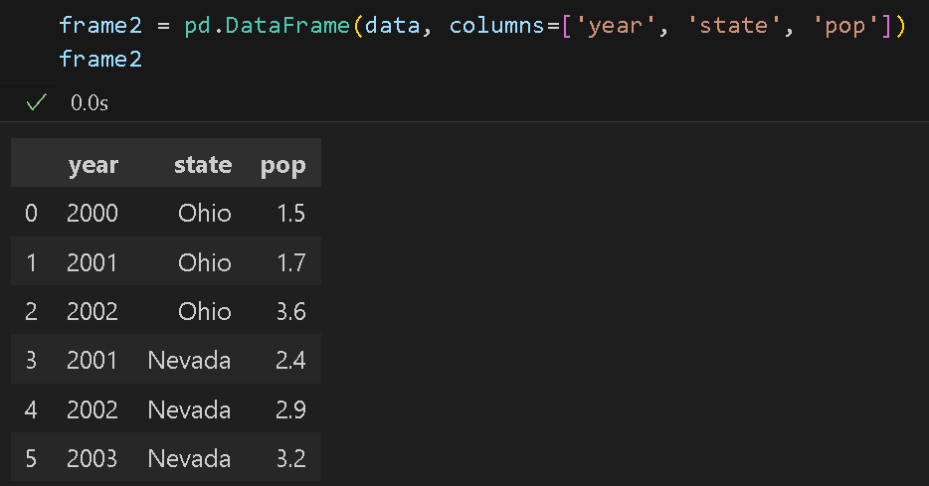
Introduction to pandas DataFrame
Rearrange DataFrame’s columns by specifying a sequence of columns.

Slide 16
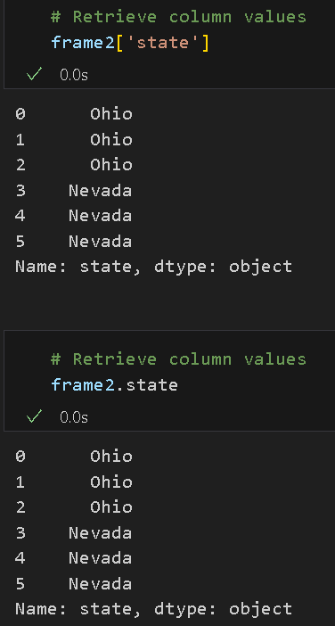
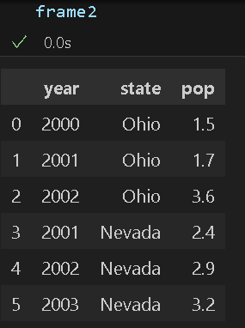
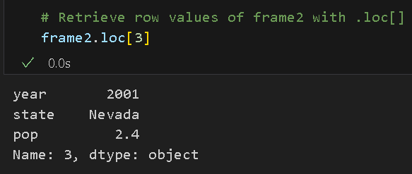
Introduction to pandas DataFrame
Retrieving a column in a DataFrame as a Series either by a:
dict-like notation
(use column name as key)
attribute
Rows can be retrieved by a position or name with the special loc attribute.

Slide 17
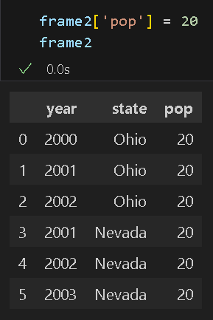
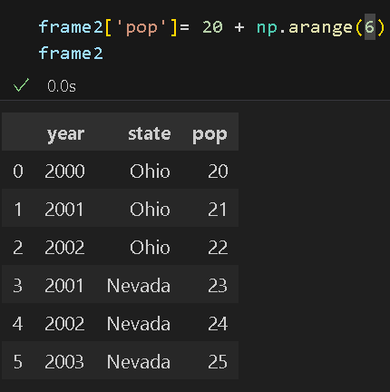
Introduction to pandas DataFrame
Values at a specific column can be modified by assignments.

Slide 18
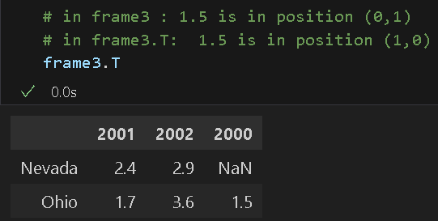
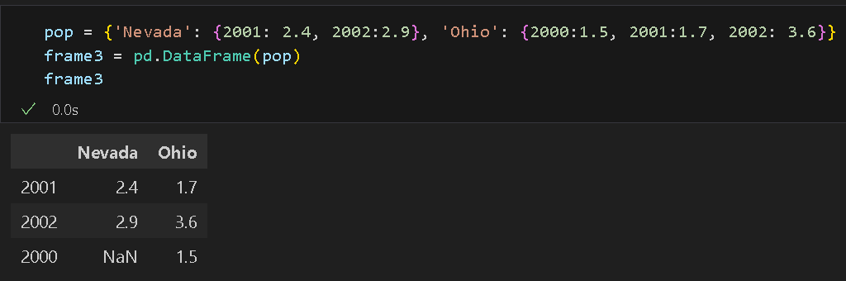
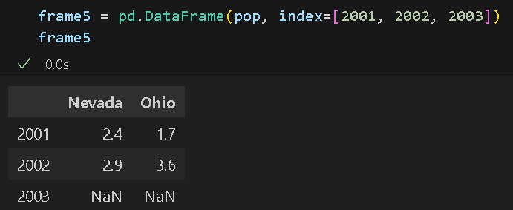
Introduction to pandas DataFrame
Another common form of data is a nested dict of dicts.
Transpose of the DataFrame (swap rows and columns)
We can display a selection of indexes (rows)
#How many NaN’s?

Slide 19
Pandas Essential Functionality:

Slide 20
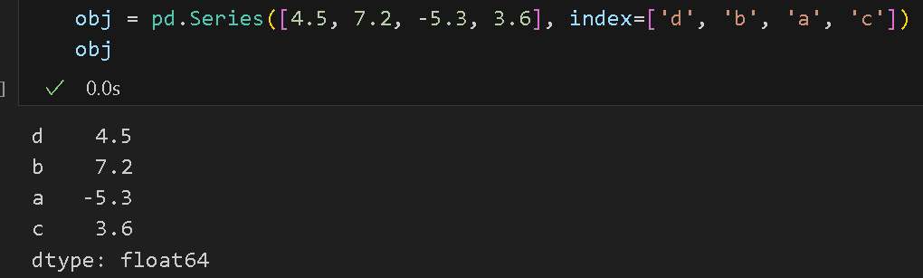
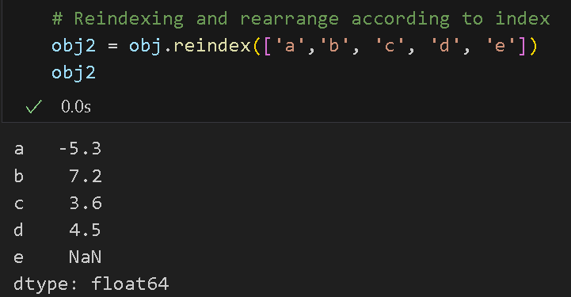
Reindexing
panda’s Index objects are responsible for holding the axis labels and other metadata (like the axis name or names).
Reindex on this Series rearranges the data according to the new index.
#NaN is created for a missing value.

Slide 21
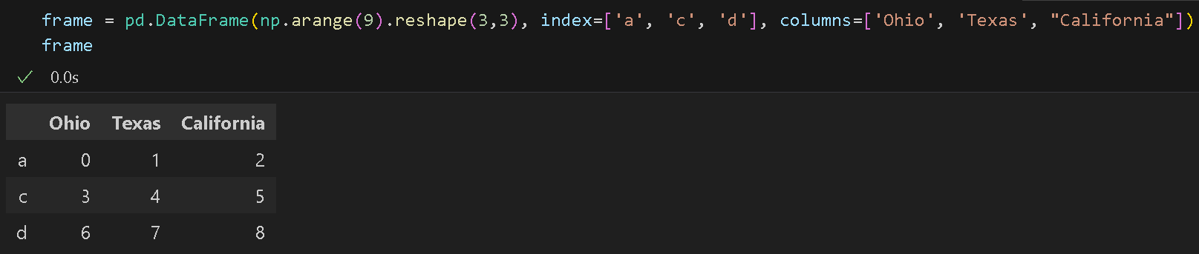
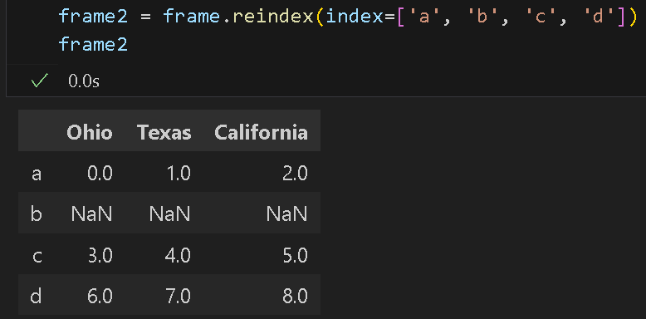
Reindexing
Rows are reindexed if only the sequence is passed.

Slide 22
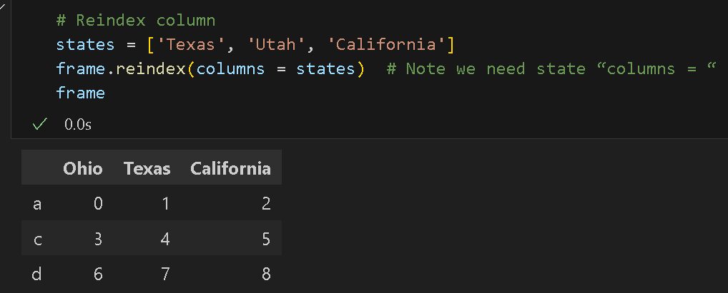
Reindexing
Columns can be reindexed as well.
Why does Utah have values NaN?
What would happen for the following command?
frame.loc[['a', 'b', 'c', 'd'], states]

Slide 23
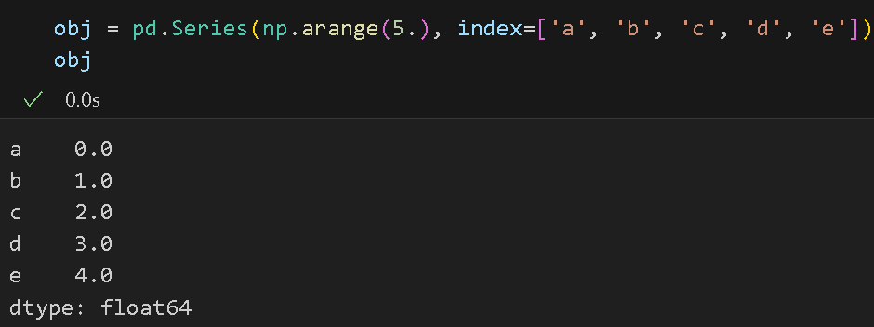
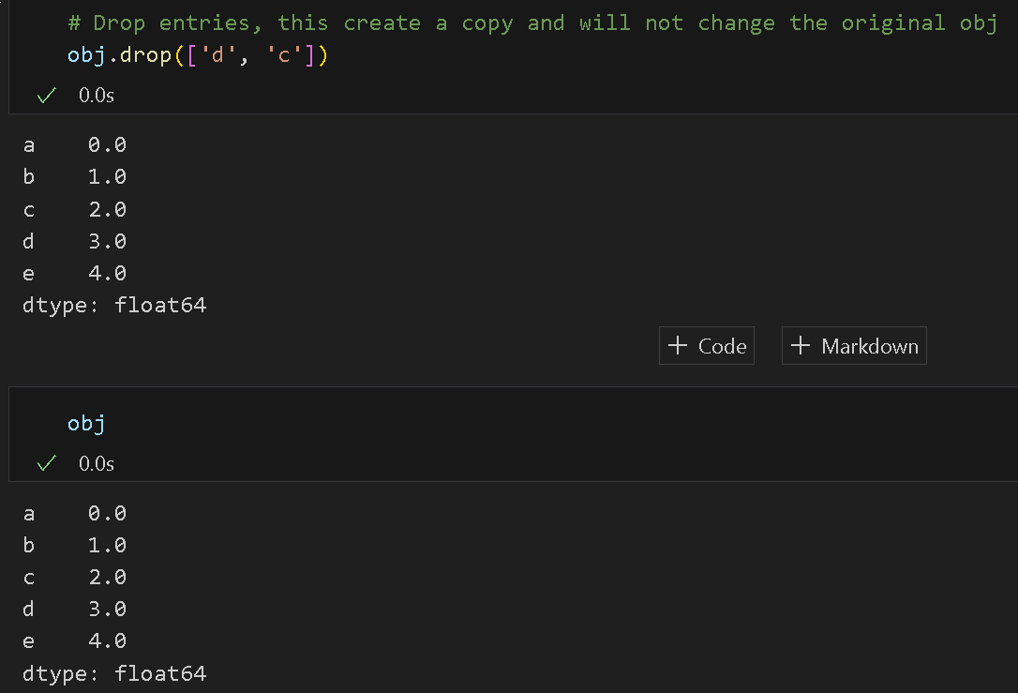
Dropping Entries
Dropping one or more entries from an axis is easy if you have an index array or list without those entries.

Slide 24
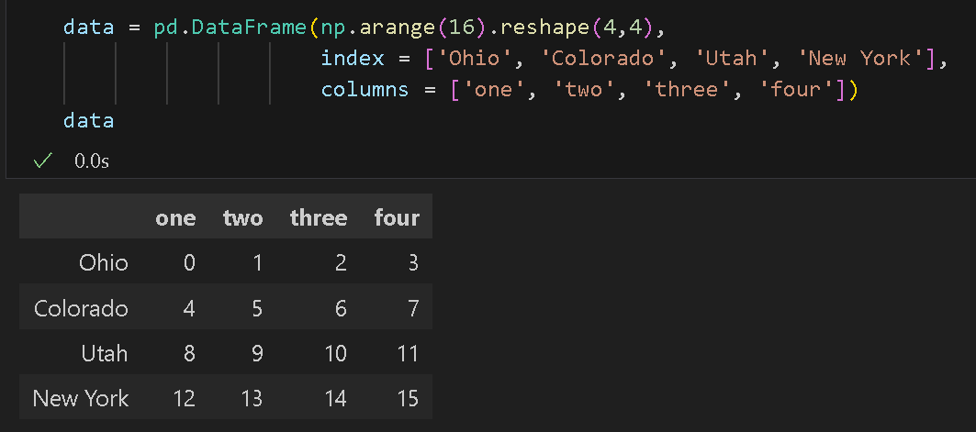
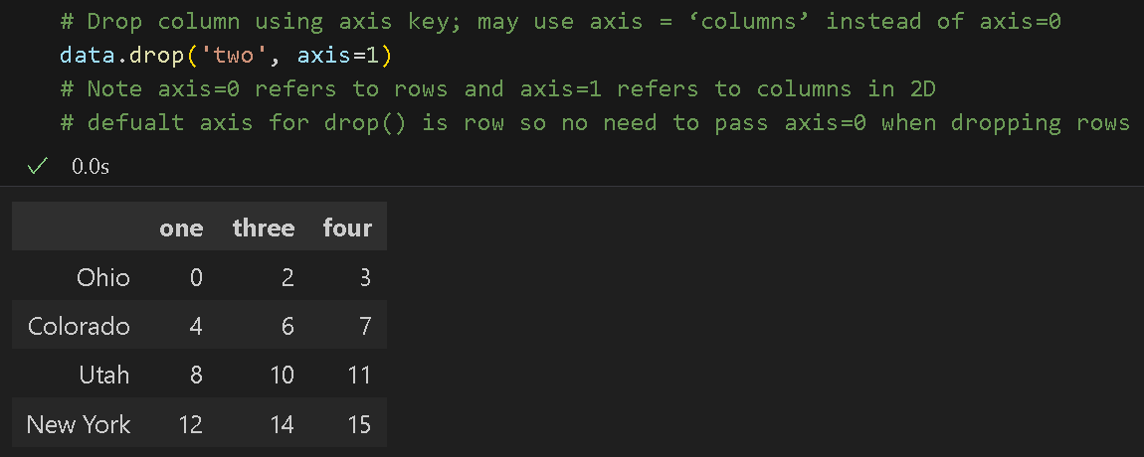
Dropping Entries
With DataFrame, you can also delete from either axis.
What would be a command to delete the last two rows? Do we need to specify axis?

Slide 25
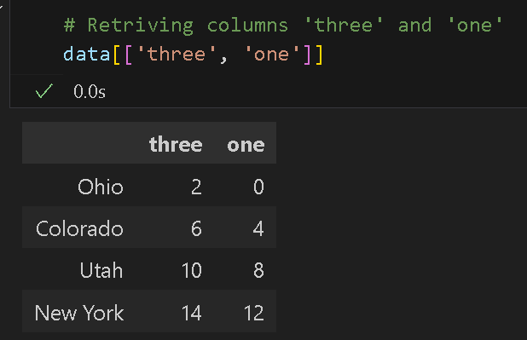
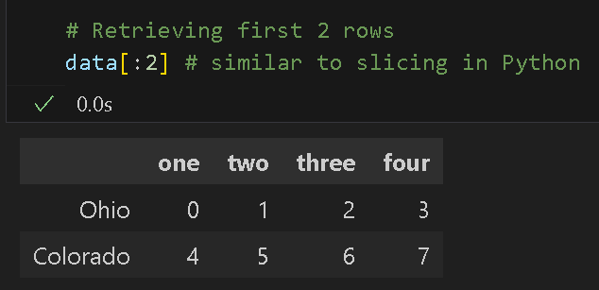
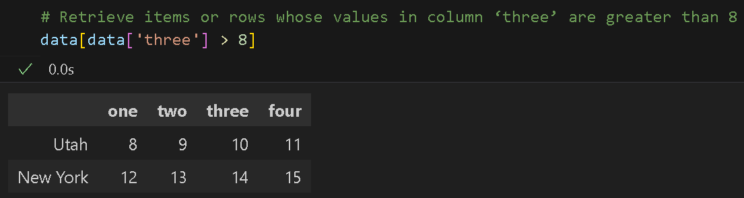
Indexing, Selection, and Filtering
indexing allows retrieving one or more columns either with a single value or sequence

Slide 26
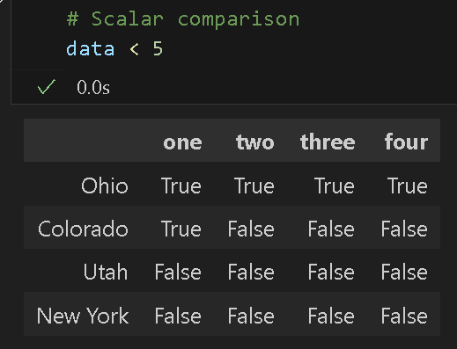
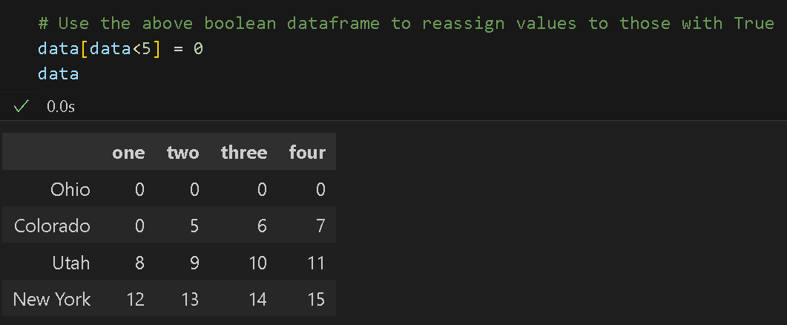
Indexing, Selection, and Filtering
a scalar comparison produced indexing with Boolean DataFrame
Example use:

Slide 27
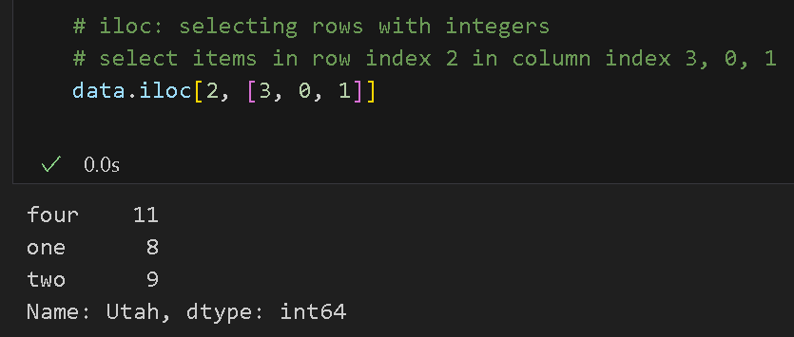
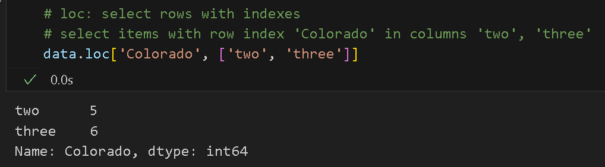
Indexing, Selection, and Filtering
Special indexing operations loc and iloc use to select a subset of the rows and columns from a DataFrame.

Slide 28
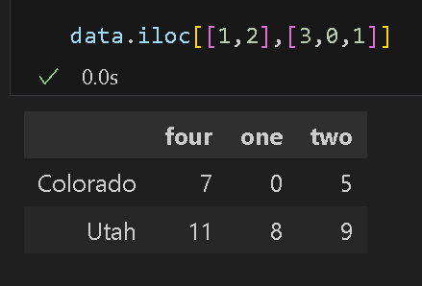
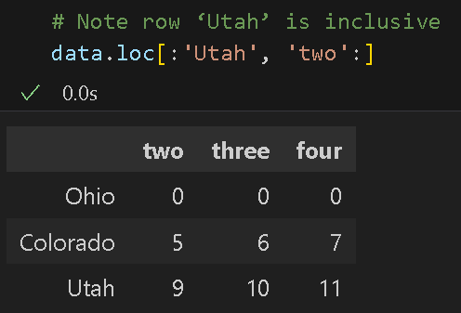
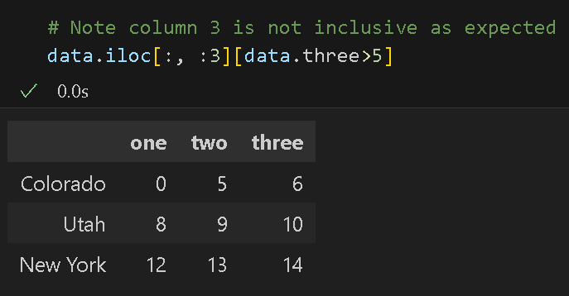
Indexing, Selection, and Filtering
More Examples - iloc and loc:

Slide 29
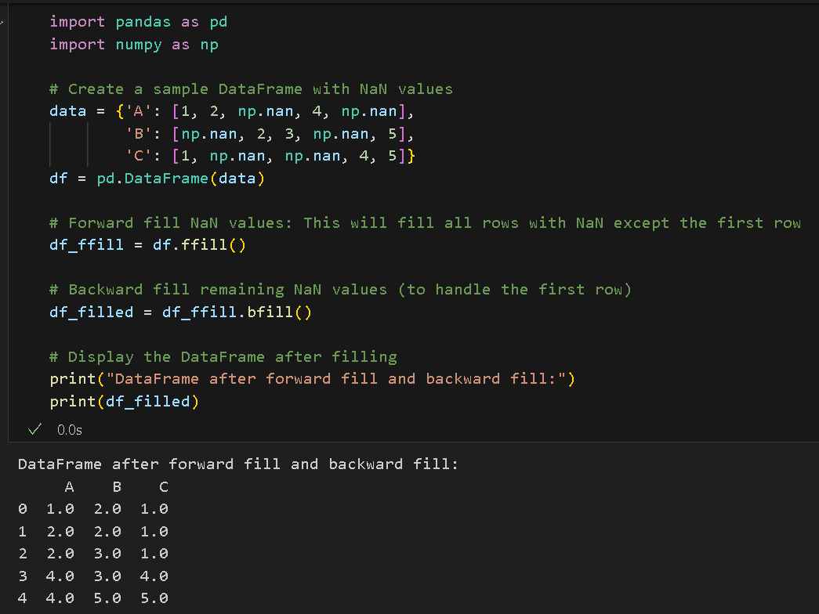
Fill Nas and NANs
Use forward ffill() and backward bfill()

Slide 30
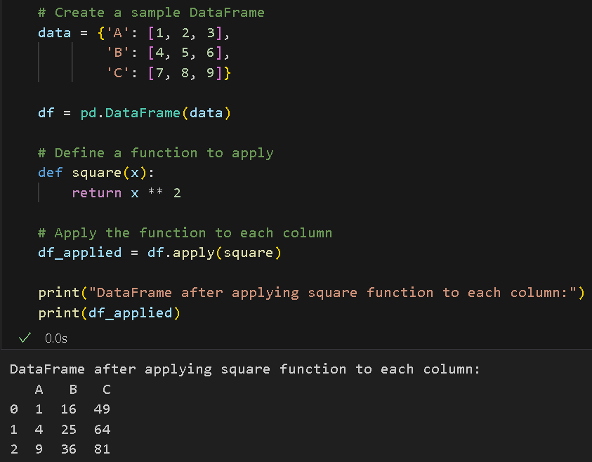
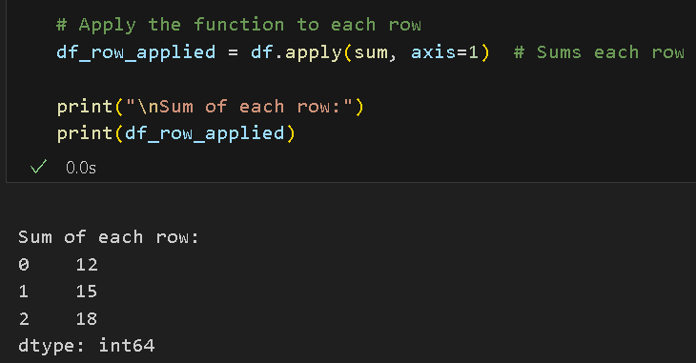
application and mapping
apply() function applies a function along an axis of the DataFrame (either rows or columns).
Useful when you want to perform operations on each row or column individually.

Slide 31
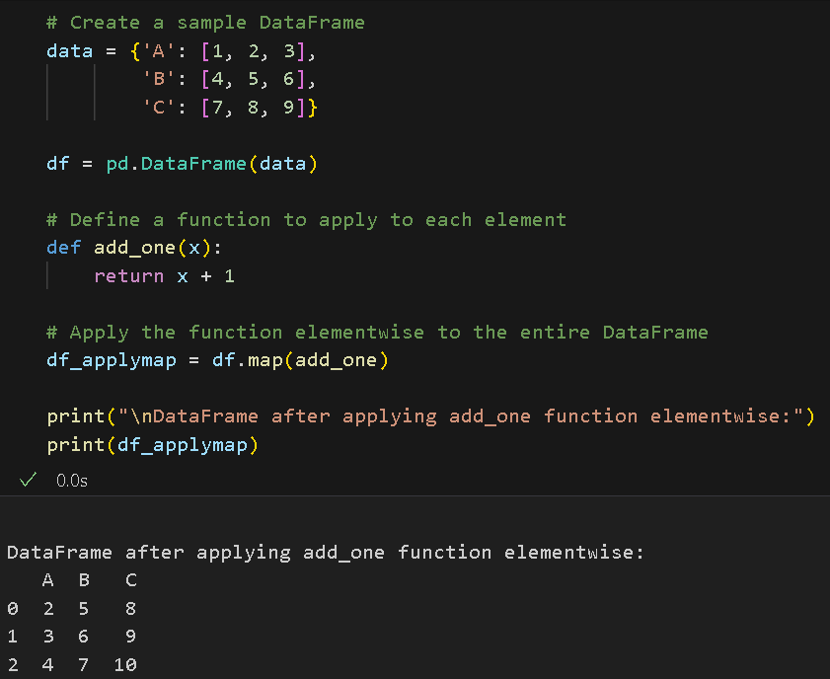
application and mapping
map() function is used to apply a function elementwise to every single element in the entire DataFrame.
This is different from apply(), which works along an axis.

Slide 32
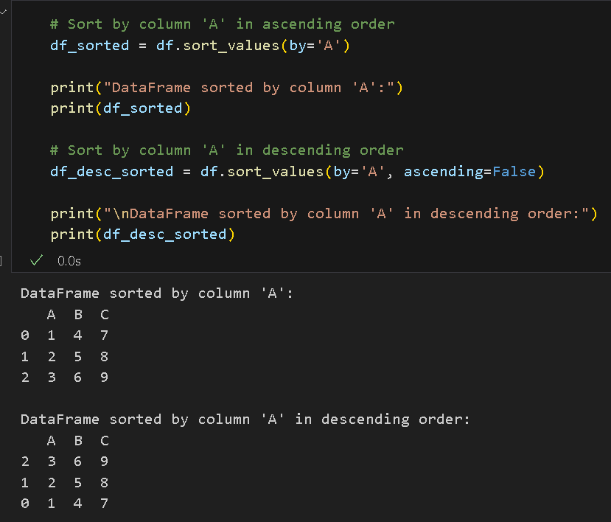
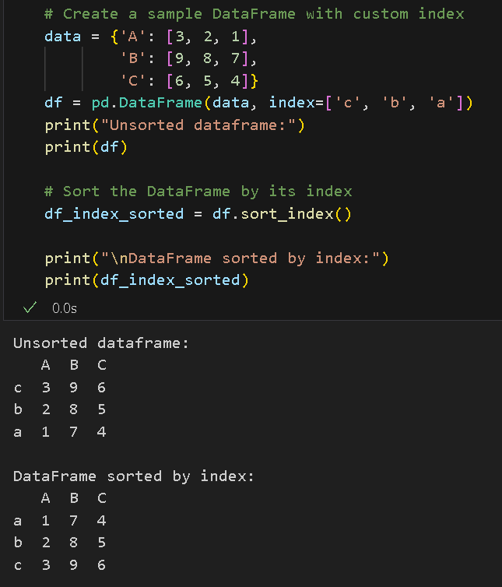
Sorting and Ranking
sort_values() - sorts a DataFrame by one or more columns
sort_index() - sorts the DataFrame by its index

Slide 33
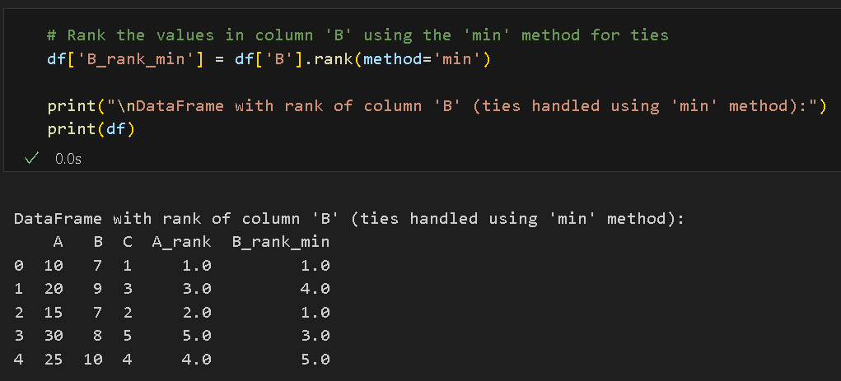

Sorting and Ranking
rank() is used to rank data in a DataFrame or Series.
Ranks are assigned to each element in ascending order by default, with ties being handled based on the specified method (such as "average", "min", "max", etc.).

Slide 34
References
references
McKinney, W. (2022). Python for Data Analysis: Data Wrangling with Pandas, Numpy, and IPython. O’Reilly. (ISBN: 1-0981-0402-1)
McKinney, W. (2022). Python for Data Analysis: Data Wrangling with Pandas, Numpy, and IPython. O’Reilly. (ISBN: 1-0981-0402-1)

Slide 35

Thank you!

